Slide 1

GOVERNMENT COLLEGE OF ENGINEERING BARGUR ( AUTONOMOUS)
PROJECT TITLE: COVID – 19 CASES ANALYSIS
TEAM MEMBERS:
SHALOME A
BALAJI S
KAMALAKANNAN V
THANGARAJ S
VARUN KUMAR M

Slide 2
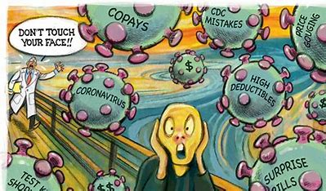
PROBLEM STATEMENT:
The project aims to analyze and visualize COVID-19 cases using real-time data to gain insights, inform the public, and contribute to the understanding of the pandemic.

Slide 3
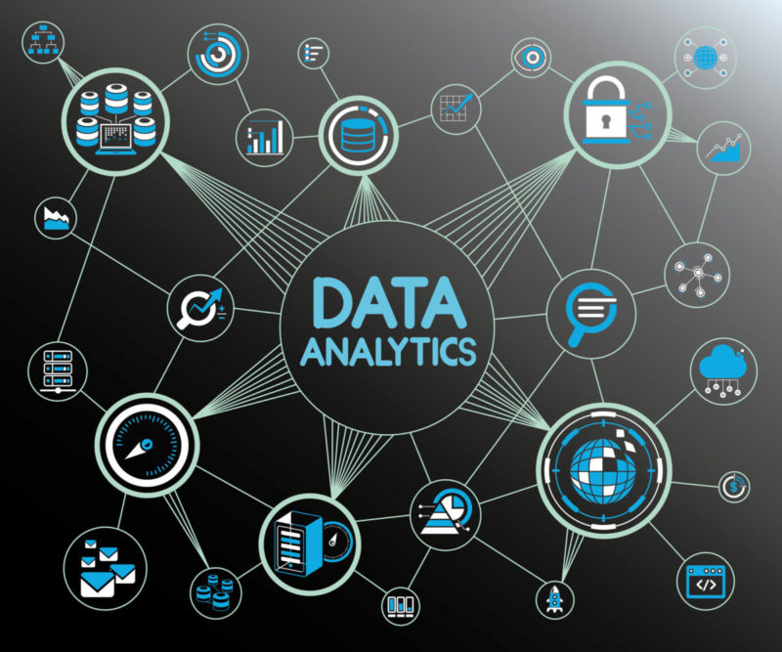
DATA ANALYTICS
Data analytics is the process of examining, cleaning, transforming, and interpreting data to discover meaningful patterns, draw conclusions, and support decision-making. It involves the use of various techniques and tools to extract valuable insights from data.

Slide 4
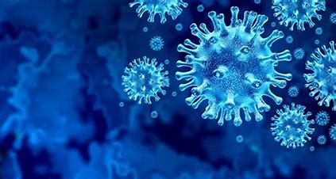
COVID 19-CASES
COVID-19, caused by the novel coronavirus SARS-CoV-2, is a global pandemic that has affected countries around the world.
Key points related to covid-19 cases are:
Spread and Transmission
Symptoms
Testing
Case Tracking
Vaccination
Variants
Public Health Measures
Global Impact
Ongoing Research

Slide 5
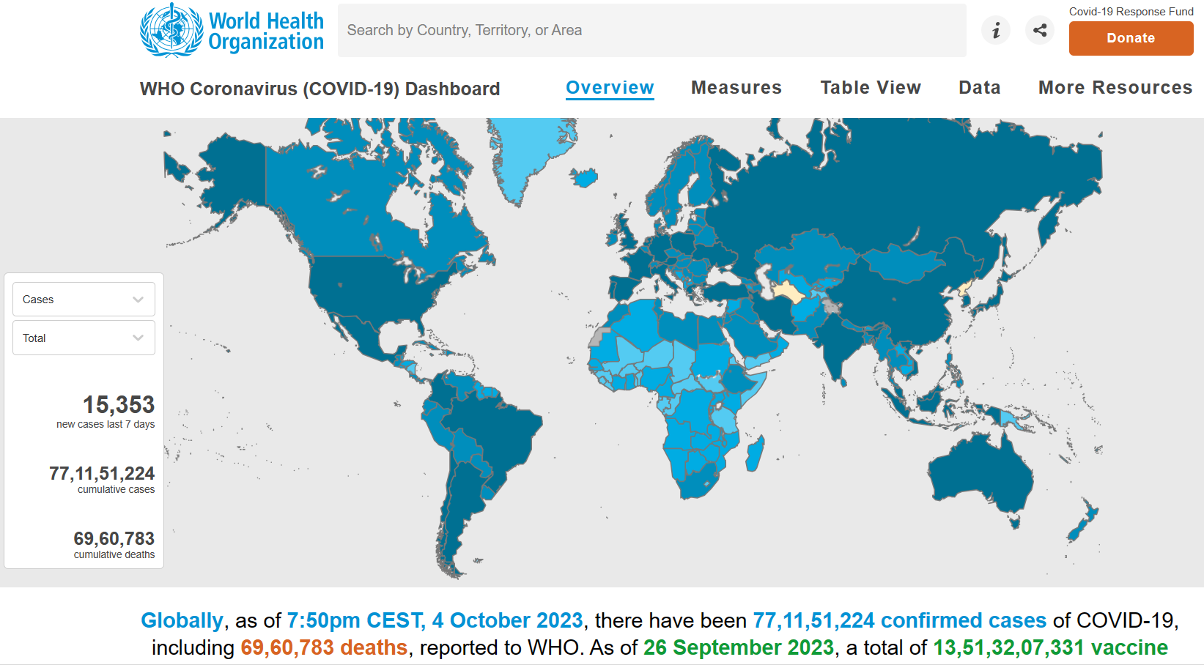

Slide 6
COVID-19 CASES ANALYSIS
Data Collection: Gather real-time COVID-19 data from reliable sources such as government health agencies, the World Health Organization (WHO), and data repositories like Johns Hopkins University's COVID-19 Dashboard. This data should include information on the number of cases, recoveries, deaths, testing, and other relevant metrics. Ensure that you have a reliable and up-to-date data source.
Data Cleaning and Preprocessing: Process the data to remove any inconsistencies, missing values, or duplicate entries. Ensure data quality and integrity before analysis.
Exploratory Data Analysis (EDA): Perform EDA to understand the data's characteristics. Generate summary statistics, visualize trends, and identify any anomalies or outliers.

Slide 7
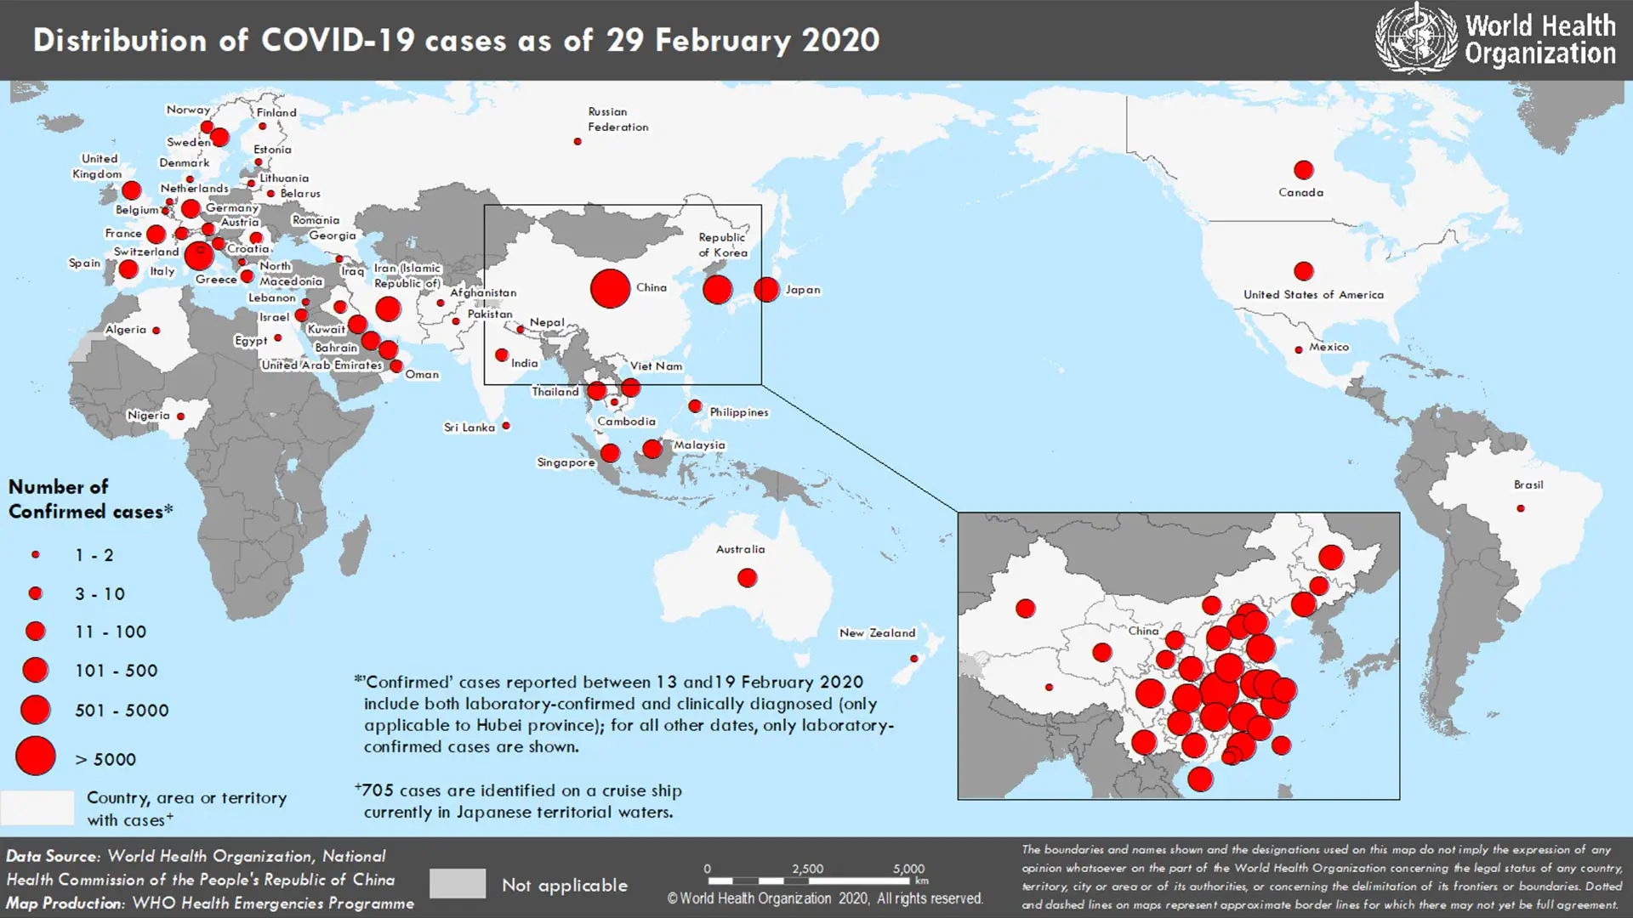
Data Visualization: Create visualizations such as line charts, bar graphs, heatmaps, and geographic maps to present the data in an understandable and informative way. Tools like Tableau, Power BI, or Python libraries like Matplotlib and Seaborn can be useful for this purpose.
Real-time Updates: Implement a system to regularly update and refresh the data to keep it real-time. You can automate data retrieval and processing using scripts or data integration tools.
Geospatial Visualization: Use geospatial data visualization to display the spread of COVID-19 on maps. Tools like Leaflet or GIS software can help with this.

Slide 8
Trend Analysis: Analyze the data to identify trends, patterns, and hotspots. For example, you can analyze the growth rate of cases in different regions or countries.
Statistical Analysis: Conduct statistical tests to derive insights, such as the correlation between testing rates and infection rates, or the impact of public health measures on the curve.
Predictive Modeling: You can build predictive models to forecast the spread of the virus based on historical data and known variables. Time series analysis and machine learning can be used for this purpose.
Interactive Dashboards: Create interactive dashboards that allow users to explore the data and gain insights. Tools like Tableau, Power BI, or custom web development with JavaScript can help in building these dashboards.
Public Communication: Share your findings and visualizations through public channels like a website, social media, or data visualization platforms. This can help in informing the public and raising awareness.
Data Source Attribution: Always provide proper attribution to the data sources used in your project.

Slide 9
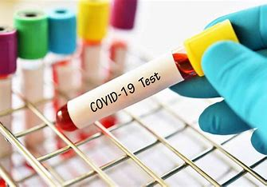
Ethical Considerations: Given the sensitivity of the topic, be mindful of ethical considerations, such as privacy and ensuring that your project's purpose is to inform and not cause panic.
Collaboration: Consider collaborating with epidemiologists, public health experts, and data scientists who have expertise in infectious diseases for a more comprehensive analysis.
Documentation: Document your data sources, methodologies, and findings comprehensively to make your project transparent and reproducible.
Feedback Mechanism: Encourage user feedback and engagement to improve your project and address any concerns or questions from the public.

